Slide 1



Chowgacha – Jhenaidah Community Engazed Health Management Model
Dr. Md.Emdadul Haque
Senior Nation Consultant C -J model replication committee

Slide 2
Comparative data of health facilities of different country of the world
SL NO | Country | Per capita health Expenditure per year by Govt. ($) | Doctors per 10000 Population | Nurse per 10000 Population | Beds per 10000 population | Out of pocket expenditure %
01 | USA | 9536 | 25.5 | 99 | 37 | 11.08
02 | UK | 4356 | 28.0 | 84 | 30 | 14.79
03 | Malaysia | 386 | 12.8 | 34 | 18 | 36.67
04 | Sri Lanka | 118 | 7.3 | 17.5 | 31 | 38.43
05 | India | 63 | 7.3 | 20.4 | 09 | 65.06
06 | Nepal | 44 | 08 | 4.7 | - | 60.41
07 | Pakistan | 38 | 08 | 06 | 06 | 66.40
08 | Bangladesh | 37 | 3.9 | 03 | 03 | 67.00
From internet 2018

Slide 3


CHOWGACHA UPAZILA HEALTH COMPLEX
Chowgacha, Jessore.
Previous UHC in 1986

Slide 4
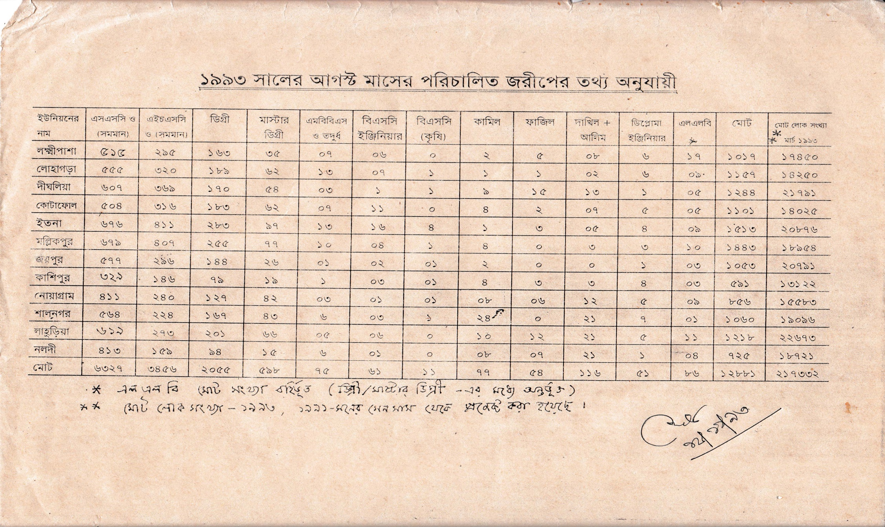
নড়াইলের লোহাগড়া উপজেলায় ইউনিয়নওয়ারী জরীপে জনসম্পদের তথ্য

Slide 5




Community Mobilization Meeting at Lohagara in 1995

Slide 6
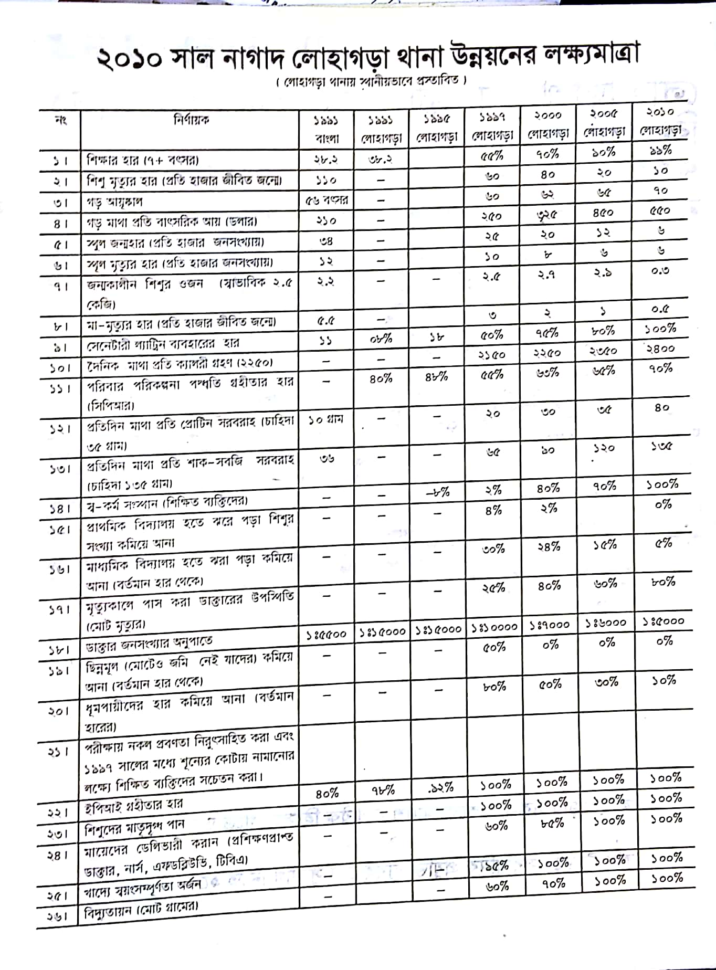

Slide 7

50 BEDED UPAZILA HEALTH COMPLEX
Chowgacha, Jessore.

Slide 8
A Sub-district level Hospital with a Vision …
Maximum utilization of Govt.
resources with
honesty and sincerity.
Integrated approach of
Administration, Community
Leaders .
Providing Effective services
through improved
management system.

Slide 9
Background History of Community Engagement C-J model
In 1986, UHC is extended to nearby Public Library and opened 6 bedded indoor made a EPI building with the help of Upazilla Parishad.
In 1994, health complex shifted to new 31 bedded hospital, with 6 bedded labour ward.
UHFPO opened 4 special activities headed by medical officers in 1996
From January 1996 to 1998 JICA assistance in Frontline MCH Program
< Special activities>
ANC-Corner
Basic EOC service
Under 5 corner for under 5 children
Monthly birth and death record

Slide 10
C-J model Contd.
Form November 2000 started Comprehensive EOC program.
From August 2006 Safe Blood Transfusion unit established .
From April 2007 Demand Side Financing (DSF) program started.
Hospital is declared as model health complex on 20 June 2008 and upgraded to 50 bedded hospital by MOH&FW.
Chowgacha health complex Model is replicable through out the country. Declared by D.G. WHO on 8th March 2010.
Major Killer Disease (NCD) prevention program starts in 1st January-2011.
TQM activates starts in July 2011 by the support of JACA.
The health complex planed to upgrade to 100 bed hospital

Slide 11
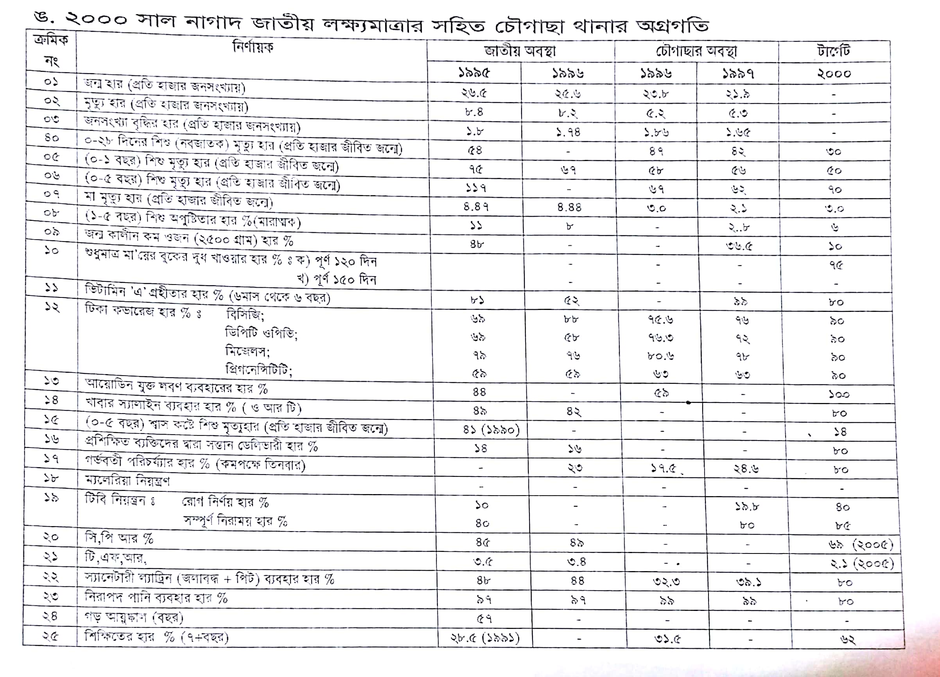

Slide 12
Upazila Health Complex
CHOWGACHA , JESSORE.
EOC ACTVITIES : ( Vision By The Year 2010)
SL No | Indicator | Achived |  |  |  |  |  |  |  | Target
 |  | 1997 | 2000 | 2003 | 2005 | 2006 | 2007 | 2008 | 2009 | 2010
01 | ANC 1st Visit % | 24.6 | 59 | 88 | 94.7 | 110.8 | 133.7 | 143.0 | 147 | 100
02 | ANC 2nd Visit % | 11.6 | 33.4 | 59.7 | 68 | 78 | 91.2 | 108 | 119 | 100
03 | ANC 3rd Visit % | 9.2 | 22 | 30 | 39 | 40 | 49.6 | 59.6 | 109 | 100
04 | PNC % | - | 5.5 | 9.9 | 13.5 | 20.11 | 11.2 | 39.3 | 64 | 80
60 | Hospital Delivery Rate% | 3.4 | 6.4 | 15 | 26.5 | 32.3 | 38.1 | 52.4 | 72 | 90
06 | Caesarian Section Rate% | 0 | 0.07 | 0.8 | 6.3 | 7.4 | 9.6 | 11.0 | 17.3 | 15
07 | Maternal Mortality Ratio / 100000 Live birth | 210 | 168 | 114 | 160 | 150 | 160 | 120 | 42 | 42
08 | Neonatal Death Rate / 1000 live birth | 42.4 | - | 28 | 21.5 | 20.5 | 21.5 | 16.5 | 19.3 | 15

Slide 13


Blood donation program stared in 16 December, 1996 in Chowgacha UHC
A seminar held on basic information system at Chowgacha Degree College in June, 1997. DC Jessore was the chief guest .

Slide 14


Community supported volunteer working in ANC corner
Community Supported Volunteer Working as receptionist.

Slide 15
Upazila Health Complex
CHOWGACHA , JESSORE.
EOC Activities : 1997- 2017 (Hospital Delivery )

Slide 16
Upazila Health Complex
CHOWGACHA , JESSORE.
EOC Activities : 2000 - 2017 (Caesarian Section)

Slide 17
Upazilla Health Complex
CHOWGACHA , JESSORE.
COMMUNITY SUPPORTED MANPOWER
TOTAL :46
  Volunteers :26
  Cleaners & guards :16
  Others :04
  The remunerations come from
  Outsourcing :25
  Service provider :21.

Slide 18
Chowgacha Health Complex – improvement evaluation (1995-2017)
Subject | 1995 | 1996 | 1997 | 2000 | 2003 | 2007 | 2011 | 2017
Bed Occupancy Rate % | - | - | 78.9 | 93.5 | 88.9 | 201 | 208 | 171
ANC (First Visit) | - | 16.3 (817) | 24.6 (1228) | 59 (2861) | 88 (4484) | 132 (7292) | 170 (8935) | 130 (6632)
Hospital Delivery Rate % | - | 2.1 (99) | 3.4 (151) | 6.4 (422) | 15 (661) | 38.1 (1899) | 98.4 (4413) | 66 (2932)
C-Section rate % | - | .02 (1) | 0 | 0.07 (3) | 0.8 (36) | 9.6 (473) | 22.5 (1107) | 17
Population Increase rate | 1.87 | 1.86 | 1.66 | 1.7 | 1.57 | - | 1.36 | 1.71
Maternal Mortality Ratio/100,000 live birth | 599 | 300 | 206 | 168 | 114 | 160 | 68 | 91
Neonatal mortaliy rate/ 1000 live birth | 42 | 47 | 42.4 | 23 | 28 | 21.5 | 18.2 | 16.6
Infant mortaliy rate/ 1000 live birth | 65 | 58 | 56 | 36 | 34 | 29.2 | 23.6 | 18.6
Under 5 mortaliy rate/ 1000 live birth | 78 | 67 | 62 | 44 | 43 | 33.3 | 25.7 | 21.1
Low birth weight rate(%) | - | - | 36.5 (74) | 15.2 (288) | 13.7 (636) | - | - | -

Slide 19
Achievement of Chowgacha Health Complex
In 2008, Chowgacha Health Complex declared as the model Upazilla health complex.
  Mobilized 46 additional workers from community (26 volunteer, 12 cleaners and others 8).in2011 & 41 bed for EOC
  Chowgacha UHC became the best EOC center with ANC 1st coverage 170%(8935)& hospital delivery rate 98.4% (4413)in 2011
  Chowgacha Health complex is awarded for best performance in EOC form 2005 to 2014.
  Achieve Health minister s Award for its best performances and also for EOC.in2017,2018.
  The govt. taken the initiative to upgrade to 100 bedded in 20018.

Slide 20



Slide 21


Slide 22

100 kh¨v wewkó m`i nvmcvZvj, wSbvB`n

Slide 23
Background History of Community Engagement Jhenaidah model
Model starts in 2012 with the help of BPATC, SAVAR.
In2014 Jhenaidah team visit Satkhira with the help of JICA
Initiative of Piloting District Hospital Model by MOH&FW in 2015
In 2016 Replication of Jhenaidah model in 10district hospital
Order to replicate the model by Prime Ministers office in 2017 .
A Techinical Committe was formed by DGHS to replicate in 2018
Replicatin starts in 20 distrct & 40 upazilla hospital by DGHS

Slide 24
Challenges of the hospital in 2012
In secured hospital environment.
Performance of all activities was very low.
Very limited support staff.
Receiving money from the patients by non-govt. staff.
Waste management system was poor.
Monitoring meeting was not performed regularly

Slide 25




KAIZEN in Jhenaidah Sadar Hospital

Slide 26




Changes in EOC Ward
Before
After
Before
After

Slide 27







Changes in pediatric ward and waste management
Before
After

Slide 28
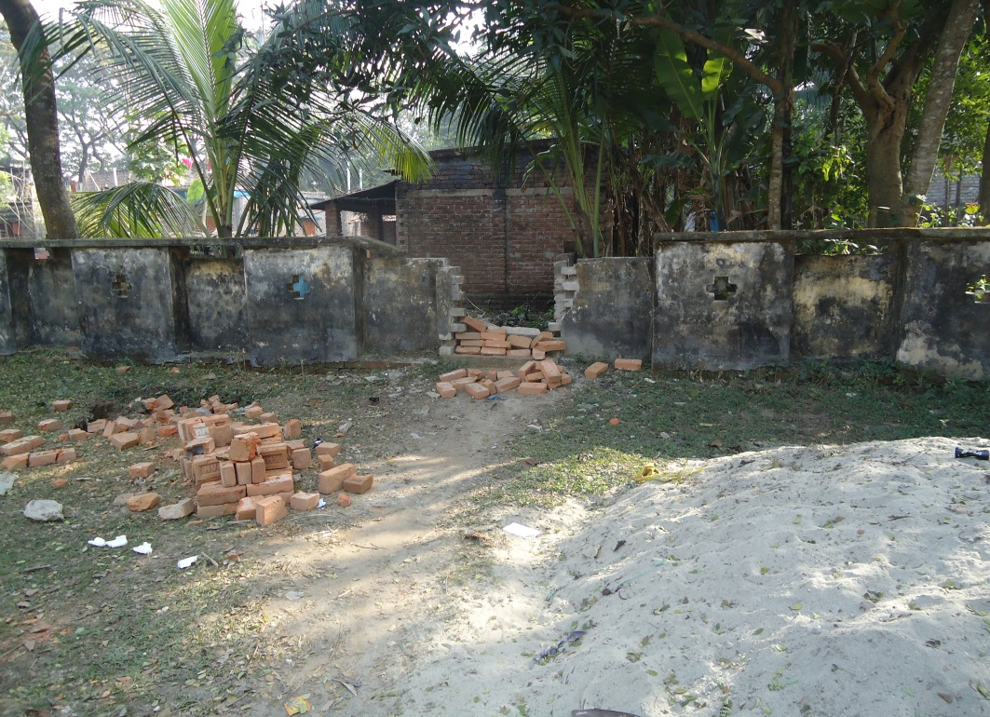
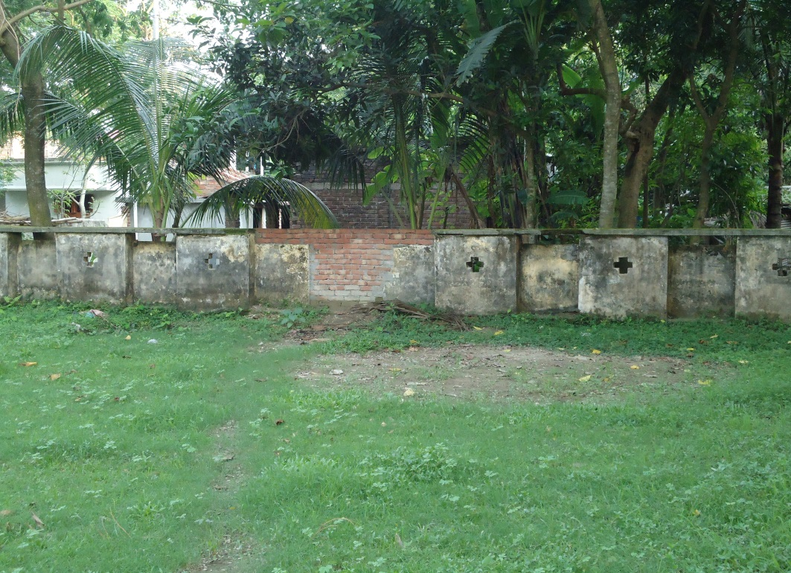


Local Govt. (Paurashava) Participation

Slide 29




KAIZEN in Jhenaidah Sadar Hospital
Color code
Color code
Use of direction sign
waist segregation

Slide 30




Innovative activities of Jhenaidah Sadar Hospital Page: 1
Reception room
Creation of nursing aid
Health education session
Community engagement

Slide 31





Innovative activities of Jhenaidah Sadar Hospital Page: 2
Starting of 5S KAIZEN-TQM
Neonatal Care Unit
Manobota
Big Cleaning Day

Slide 32



Improved pediatric word by local initiative

Slide 33


KAIZEN in Jhenaidah Sadar Hospital
Recovered Valuable land after sixty years.
Arranged get man to control crowed in ward by Community support

Slide 34
Community Support System in Sadar Hospital
Human resource 56 (Cleaner 21, Ayah & ward boy 22, Guard 7, Volunteer 3, Trolley man 3 )
MP of Jhenaidah-2 supports 14, Zahedee foundation 12 , Mayor of Jhenaidah Paurasava 4, , doctors of Jhenaidah support 17 manpower.
Mayor of Jhenaidah Paurasava plays a role in security , cleanliness, renovation of pediatric word and arrange a mayoral conference.
Retired secretary provide a generator, Zahedee foundation an inter-com, mayor a biochemistry analyzer.

Slide 35

Sadar Hospital, Jhenaidah
Bed Occupancy Rate from 1998 to 2018

Slide 36
Emergency & Out Door, Indoor Service 1998 to 2018
Sadar Hospital, Jhenaidah

Slide 37
3 best performing EmOC Hospital in Khulna division - 2017
Sadar Hospital, Jhenaidah

Slide 38
Operation Service (Major) 2011 to 2018
Sadar Hospital, Jhenaidah

Slide 39
Achievements of Jhenaidah Sadar
Hospital
1. Active Community Participation is an example in Bangladesh.
2. Improved performance of all services.
3. Improved Cleanliness and Beautification of Campus.
4. Functioning of X-Ray service and Biochemistry investigation
5. Improved Security
6. Improved Financial Management
7. “Model ” is replicating in 11 district and 5 Upazilla hospital
8. The hospital is awarded 7 times from 2013 to 2018.

Slide 40
C-J Model Replicated in District & Upazilla Hospitals
1. Chuadanga District Hospital.
2. Cok,s bazar District hospital .
3.Joypurhat District Hospital
4.Thakurjon District Hospital
5.Jessore District Hospital . 6. Monirampur UHC ,Jessore
7. Kot Chandpur UHC ,Jhenaidah
8.Monpura UHC, Bhola
9.Birganj UHC, Dinazpur
10.Malandah UHC Jamalpur

Slide 41
Need to implement health related SDG
by 2030
01 M.A in every community clinic
10 bedded hospital with 2 doctors, 6 nurses and paramedics in every union.
100 bedded hospital In every Upazilla
500 bedded hospital in every district.

Slide 42




Hospital Environment

Slide 43

Thank You
Notes:
43

